Slide 1
Medical staff Wellness amongst covid-19

Slide 2
CONTROL WHAT YOU CAN CONTROL
YOUR DAILY ROUTINE!

Slide 3
INCREASE YOUR SELF CARE
Pay special attention to basic needs
Diet, exercise, sleep, social connections
Be compassionate with yourself if you cannot get everything done
Practice calming rituals
Stay grounded in the present moment
KEEP THINGS IN PERSPECTIVE
Use online resources or apps for meditation
Engage in soothing hands-on actives like arts and crafts or getting out into nature

Slide 4
Reduce or eliminate unhelpful coping strategies
Alcohol, tobacco and other drugs don’t eliminate but rather exacerbate the problem!

Slide 5
Maintaining good mental health
Limit exposure to news and social media
A near-constant stream of news reports about an outbreak can cause anyone to feel anxious or distressed
Twice a day is enough for important updates
Seek accurate information from the WA Department of Health
Pay attention to positive news. AVOID LISTENING TO OR FOLLOWING RUMOURS THAT MAKE YOU FEEL UNCOMFORTABLE!
Practice daily gratitude

Slide 6
EVIDEncE BASED MEDICINE FOR MAINTaiNING OPTIMAL IMMUNE FUNCTION
“HOW DO I NOT GET SICK?”
Ensure a healthy lifestyle
Diet rich in fruit and vegetables
Don’t SMOKE
Maintain a healthy weight
Get adequate sleep
Drink alcohol in moderation
Exercise regularly

Slide 7
Evidence BASED MEDICINE FOR MAINTaiNING OPTIMAL IMMUNE FUNCTION
Do I have micronutrient deficiencies?
Zinc, selenium, iron, copper, folic acid and vitamins A, B6, C, E
Depends on your diet
Addition of a multivitamin, mineral supplement may help
However, impact of these on the immune system is less clear
Herbal and immune supplements
Unclear of benefit

Slide 8
Seek help
Reach out to family and friends (maintaining social distancing)
Talk about it with others
If your normal support networks are not enough, access professional psychological services

Slide 9
Seek help
Some healthcare workers may unfortunately experience avoidance by their family or community due to stigma or fear. This can make an already challenging situation far more difficult.
If possible, staying connected with your loved ones including through digital methods is one way to maintain contact.
Turn to your colleagues, your manager or other trusted persons for social support – your colleagues may be having similar experiences to you.

Slide 10
Seek help
There may be times where more specialised mental health is needed
SCGH ED medical staff is please to contact the following mental health department:

Slide 11
Seek help
Doctors Health advisory service WA
08 9321 3098
For doctors in crisis, or not sure where to go for help with personal or health problems:
This totally confidential 24 hour health service is available to all doctors and medical students. It can be contacted by the person themselves or by a concerned family member, friend, colleague, or staff member.
http://dhas.org.au/resources/resources-for-junior-medical-officers.html

Slide 12
Seek help
Employee Assistance Program North Metro Health
Phone: 1300 687 327
An employee assistance program (EAP) is an initiative of your employer to provide you and your fellow employees with confidential counselling, coaching and support for workplace and personal issues.
Your own GP
You must have your own GP! The “GPs for Doctors” program, run by Medicare Locals, provides information on self-care and a list of GPs who have offered to assist in treating their colleagues.
http://www.dhas.org.au/contact/personal-health-resources-for-doctors-medical-students-and-families-in-wa.html

Slide 13
Medicare mental health
The Australian government has allocated large resources to making Medicare bulk billed telehealth (phone or video) sessions with mental health professionals available to vulnerable groups

Slide 14
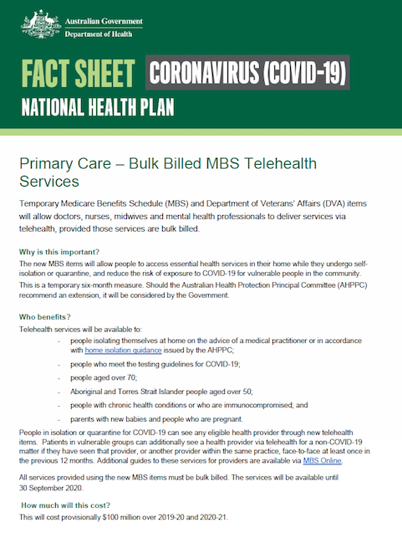

Slide 15
Reliable online counselling services
Headtohealth.gov.au
Beyond Blue
Australian Psychological services
Headspace (12-25yrs old)
Lifeline

Slide 16
AS A HEALTH CARE WORKER: HOW DO I PREVENT MY FAMILY AND PEOPLE I CARE FOR FROM GETTInG COVID 19?

Slide 18
Provider self-care tips
Don't forget to wipe down your phone, jewellery, name badge, etc.
Take a change of clothes with you to work.
Identify potentially separate living spaces and bathrooms
Designate a separate entrance into and out of the home
Change into and out of scrubs at the hospital
Shower at the hospital or immediately when you get home
Minimise accessories you bring to work and immediately sanitise them when you get home. Remember: one day at a time, one patient at a time.
Stay safe, the world needs you. You’ve got this and we’re right there with you.

Slide 19
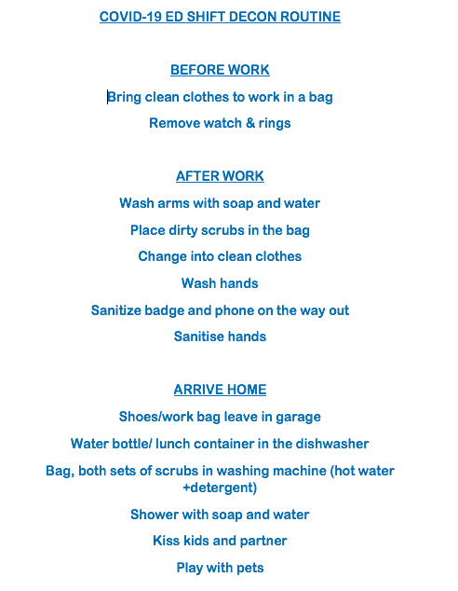

Slide 21
IF YOU NEED TO BE isolated OR QUARANTINED MAINTAING MENTAL WELLBEING
For those working from home, try to maintain a healthy balance by allocating specific work hours, taking regular breaks and, if possible, establishing a dedicated work space.
Stay connected and maintain your e-mail, social media, video conference and telephone.
Even when isolated, try as much as possible to keep your personal daily routines or create new routines.

Slide 22
IF YOU NEED TO BE isolated OR QUARANTINED
Remind yourself that this is a temporary period of isolation to slow the spread of the virus.
Remember that your effort is helping others in the community avoid contracting the virus.
Establish routines as best possible and try to view this period as a new experience that can bring health benefits.
Engage in healthy activities that you enjoy and find relaxing.
Keep regular sleep routines and eat healthy foods.
Try to maintain physical activity.

Slide 23
I am caring for someone who has (or could have) COVID-19, how can I protect myself?
Anyone in the home with a respiratory illness should be cared for in a single room, where practicable. Isolating sick residents in single rooms reduces the risk of transmission to others.
Follow the below steps to reduce chances of spreading infections at home
Frequently washing your hands for at least 20 seconds with soap and water, or using an alcohol based hand gel
Covering your cough or sneeze with a tissue or flexed elbow

Slide 24
I am caring for someone who has (or could have) COVID-19, how can I protect myself?
Avoiding close contact with anyone who has a cold or flu-like symptoms.
If it is not possible to keep the potentially infected person in a room by themselves, try to follow these principles to reduce chances of disease spread:
As a priority, place people with excessive cough and phlegm in single rooms
If there is more than one person with the same symptoms, they can be placed together in the same room
Importantly, ensure that people sharing a room are physically separated (more than one metre or arm’s length) from each other.

Slide 25
Can DOCTORS return to work if their house members are in SELF-ISOLATION?
If a house member is well but self isolating due to travel restrictions or any other reasons as per Australian national guidelines.
This member needs to maintain strict self isolation in the house for the required period of 14 days. Stay in their room and only use the toilet or kitchen as required. Not to sit in any living area. Maintain physical distance from the all other members of the house.
The doctor can to continue to work.
The employee can to go to work. However, if the family member becomes symptomatic and requires testing during the 14 days of self-quarantine, then the employee may need to self-quarantine until the results of the COVID-19 test is known.

Slide 26
Can DOCTORS return to work if their house members become symptomatic?
If a house member returns a positive COVID-19 test, that person needs to maintain strict isolation protocols
Asymptomatic close contacts should be advised to self-quarantine at home for 14 days following the last contact with the case, and to monitor their health for 14 days after the last possible contact with a conformed COVID -19 case.

Slide 27
OSH recommendations and guidelines may change during the COVID-19 pandemic
PLEASE REFER TO THE FOLLOWING SITE FOR THE MOST UP-TO-DATE GUIDLEINES
Coronavirus Disease 2019 (COVID-19)
CDNA National guidelines for public health units.
Interim advice to public health units
https://www1.health.gov.au/internet/main/publishing.nsf/Content/cdna-song-novel-coronavirus.htm
If you experience “flu-like” symptoms you can call the dedicated WA Health Staff COVID-19 Call Centre on 1800 955 765
Seek advice from your emergency department.

Slide 28
Protecting the mental health of our CHARLIE’S EMERGENCY staff
Zoom-beers
ED online community chat.
Mentor programs
Interns, RMO
Registrars
Pre and Post -shift team debriefing
Thoughts, ideas, changes, issue etc.
Facebook-”SCGH Ed Docs Essential Goods”

Slide 29
Facebook-online essential goods shop
We have created a Facebook page: SCGH ED Docs Essential Goods.
The idea behind the concept is to create a forum for people to share groceries or anything else you may need.
If you have any spare goods that you are willing to give away, please can you message/pic them on the Facebook page.
Any doctor who needs that item, just reply to the post.
The goods should be swapped in the ED rather than privately at your homes etc.
This initiative is to provide those doctors who are in need of essential goods. It is not intended to be a free for all. Please be respectful and only ask for the goods if you really need them.

Slide 30
RESOURCES
Mental Health and Psychosocial Considerations During COVID-19 Outbreak: World Health Organisation
Beyond Blue: Looking after your mental health during the coronavirus outbreak
Maintain optimal immune function: an evidence based approach
https://www.health.harvard.edu/staying-healthy/how-to-boost-your-immune-system
ED Shift Decontamination Routine
https://www.acep.org/corona/covid-19-articles/cms-announces-mips-relief/ed-shift-decontamination-routine/

Slide 31
What if I get called in to help with COVID patients?
https://covid.hippoed.com/ifigetcalledin/#selfcare
I am caring for someone who has (or could have) COVID-19, how can I protect myself?
https://ww2.health.wa.gov.au/~/media/Files/Corporate/general%20documents/Infectious%20diseases/PDF/Coronavirus/coronavirus-faqs.pdf
How do I self-quarantine?
https://www.marketwatch.com/story/how-do-i-self-quarantine-can-i-answer-the-door-or-walk-my-dog-there-can-be-legal-consequences-if-you-violate-it-2020-03-12

